Slide 1
LowesForPros.com Purchasing Tutorial Strategic Partnership
Draft 6/9/16

Slide 2
Landing Page

Slide 3
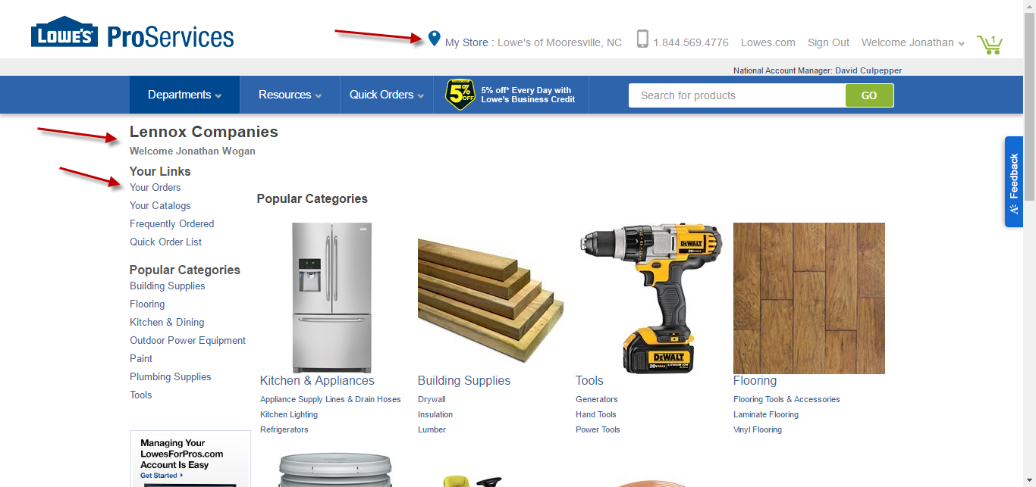
The Landing page helps you find what you need quickly Popular categories displayed are based on Property Management Needs. Select Your Catalogs to view Lennox Companies items

Slide 4
Finding Products

Slide 5
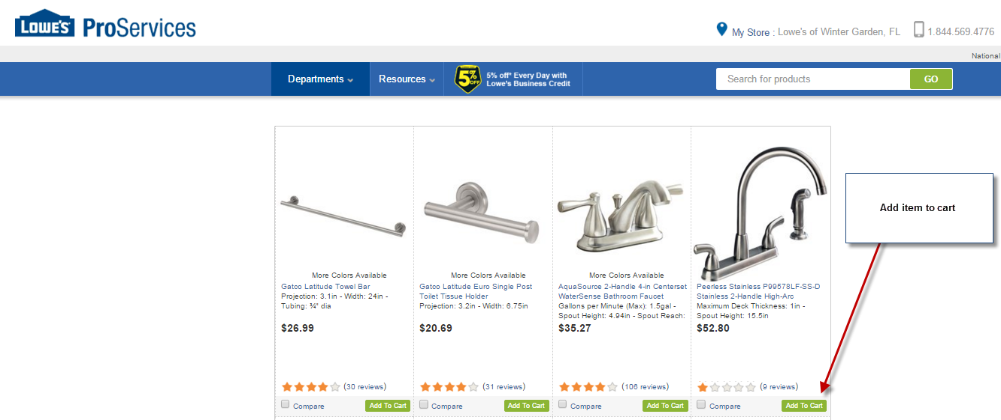
The Lennox Companies Catalog

Slide 6
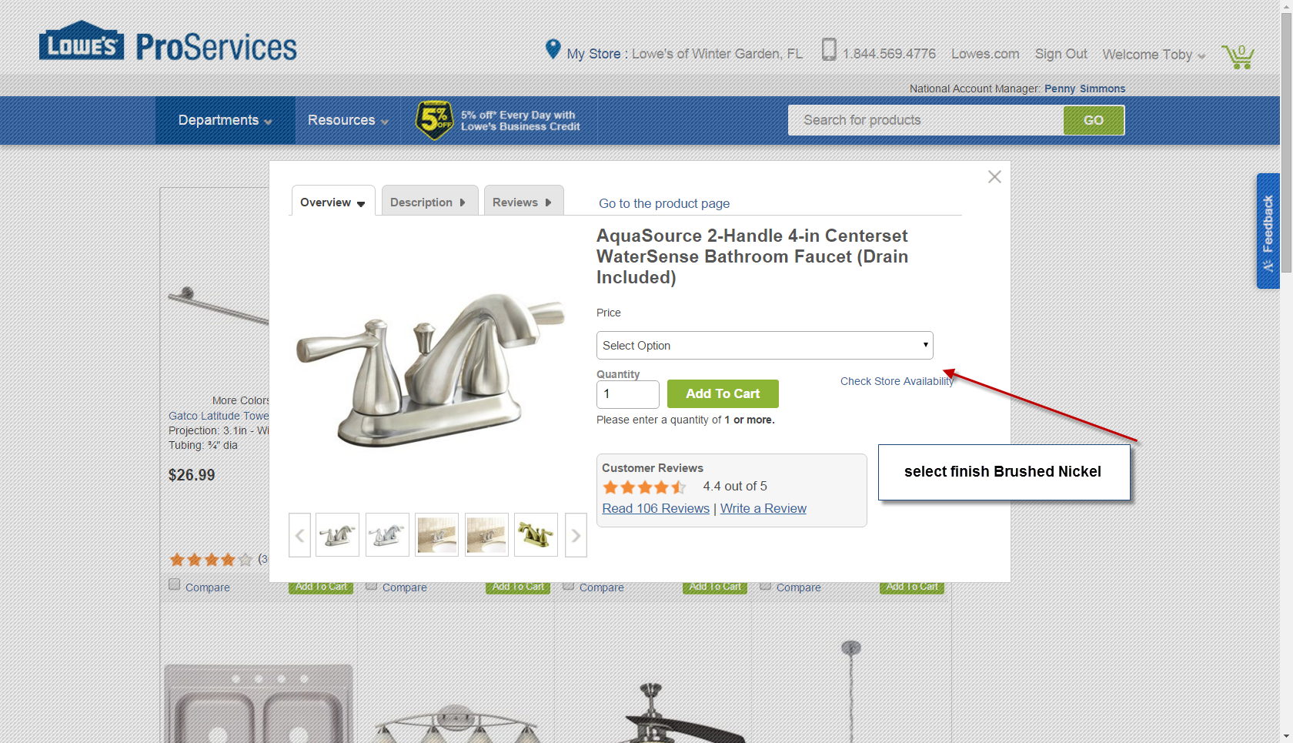
Select item / proper finish / add to the cart

Slide 7
Fulfillment option screen
Parcel shipping Free on orders over $50
Store Pickup items must be in stock and will be ready for pickup within the hour
Truck delivery store will contact buyer within 24hours to schedule best time to deliver
It is very important to select & verify the delivery option for each item!!

Slide 8
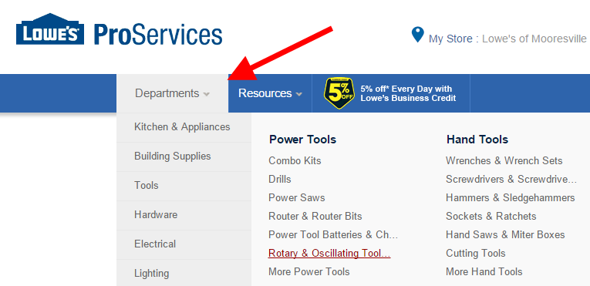
There are 3 additional Methods to Find Products on LowesForPros.com:
Specific Item / Model Number Search Keyword Search
Product Category Navigation

Slide 9
Check Store Availability

Slide 10
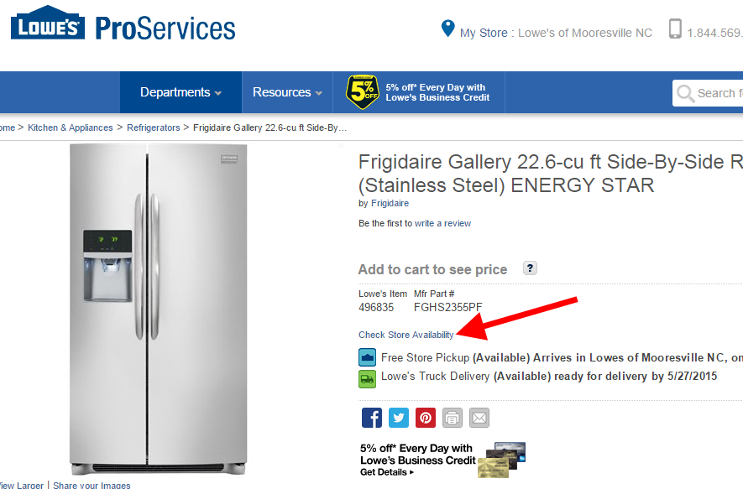
Check Store Availability
When viewing an item within the Product Detail page, item Quick View page, or the Shopping Cart, select “Check Store Availability” to see the quantity available for pickup or delivery at your selected store and others in your area.
Note: LowesForPros.com will not accept orders with quantities greater than what is available at your selected store.
You may change stores in order to locate the desired quantity.

Slide 11
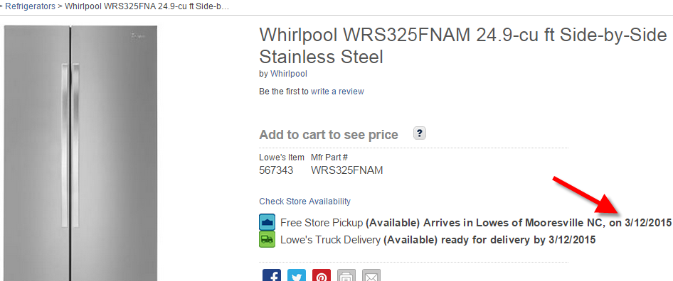
Special Order Lead Time
When an item is not in-stock at your selected store but is available through Special Order, you will see the estimated date the item will be available for Store Pickup or Truck Delivery.

Slide 12
Checkout Process

Slide 13
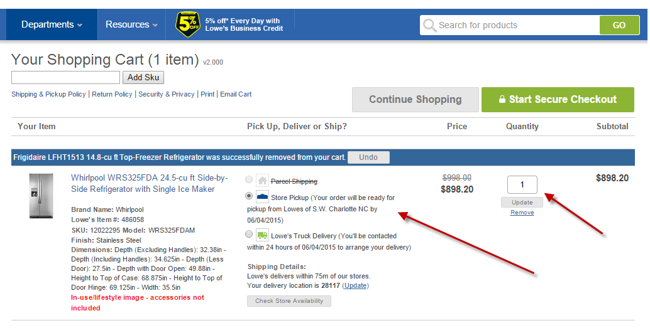
Review / Revise Your Cart
After selecting items, be sure to review your shopping cart. At this point, update the fulfillment type information and quantities of all items.
Verify the fulfillment method for all items
Multiple shipping methods are allowed within a single order
Some items may not be available for all fulfillment methods
Many Special Order (SOS) items are only available through Parcel Shipping.
After reviewing your order for the correct quantity and desired fulfillment options, select the “Start Secure Checkout” button.

Slide 14
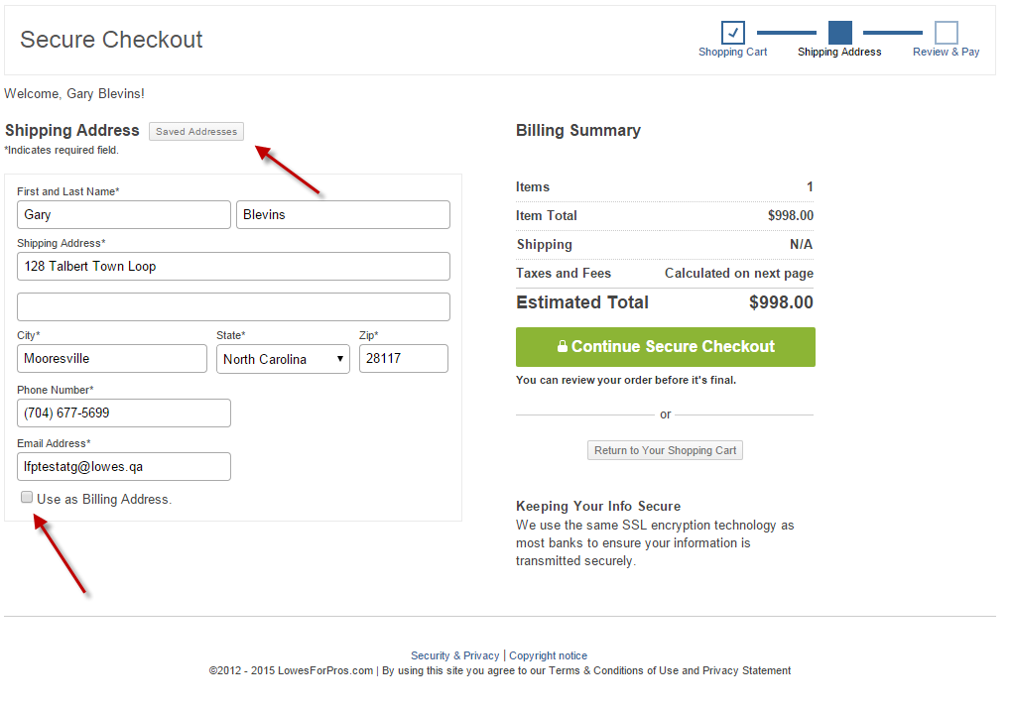
If the Parcel or Delivery option is selected, customers will need to provide a shipping address.
When entering in an address, customers have the option to save the addresses for future reference.
If your Billing Address is the same as the Shipping address, check the “Use as Billing Address” box and proceed to checkout.
If the Store Pickup option is selected, the customer will not see this page and will be directed to the final check out page/

Slide 15
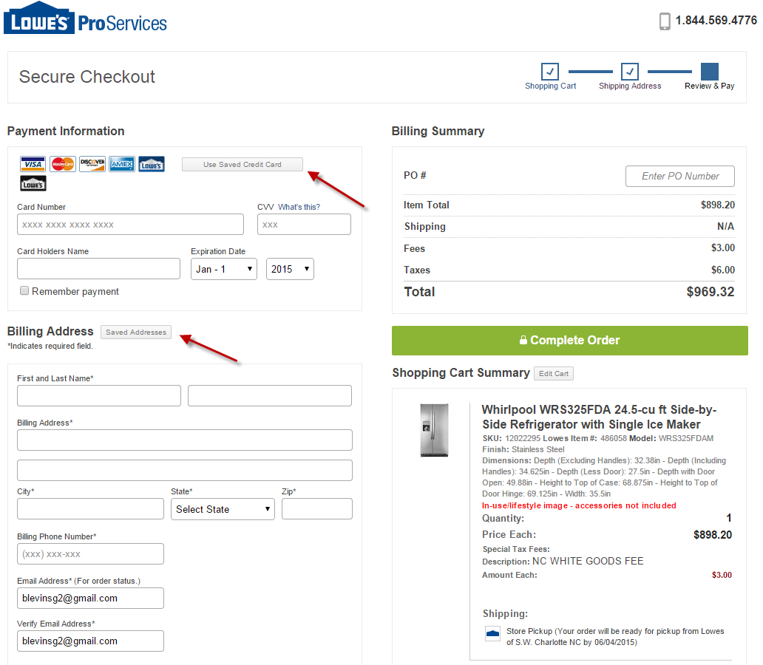
Enter Billing and LAR Payment
As with shipping addresses, you have the option to save billing addresses.
All Lowe’s Accounts will be available to choose during this process.
Refer to the Manage LAR Section for more information on linked LAR accounts.
Bill To section must match LAR account name

Slide 16
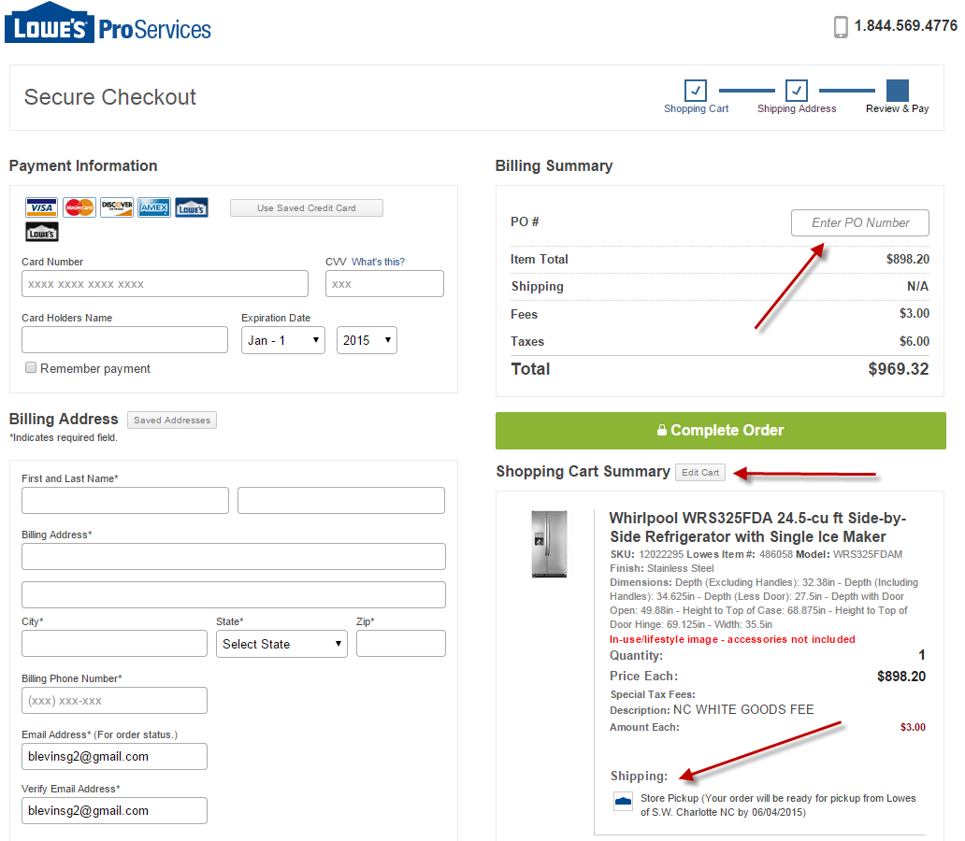
Review Your Order
Verify your store location, fulfillment method, and items are correct.
Enter a PO# if needed
No spaces or special characters
This is last time you will be able to modify your order before the purchase is complete.
Place Your Order
Check the Billing Address for accuracy
Submit your order by clicking the “Complete Order” box

Slide 17
Customer Service
Log-in & Password Assistance: LowesForPros@Lowes.com
Emergency LowesFoPros.com Issues : 1-844-569-4776
For inventory, delivery, and product questions please contact your Local Lowe’s store
Brian Aguirre
Brian.Aguirre@Lowes.com 770-639-4581

